Slide 1
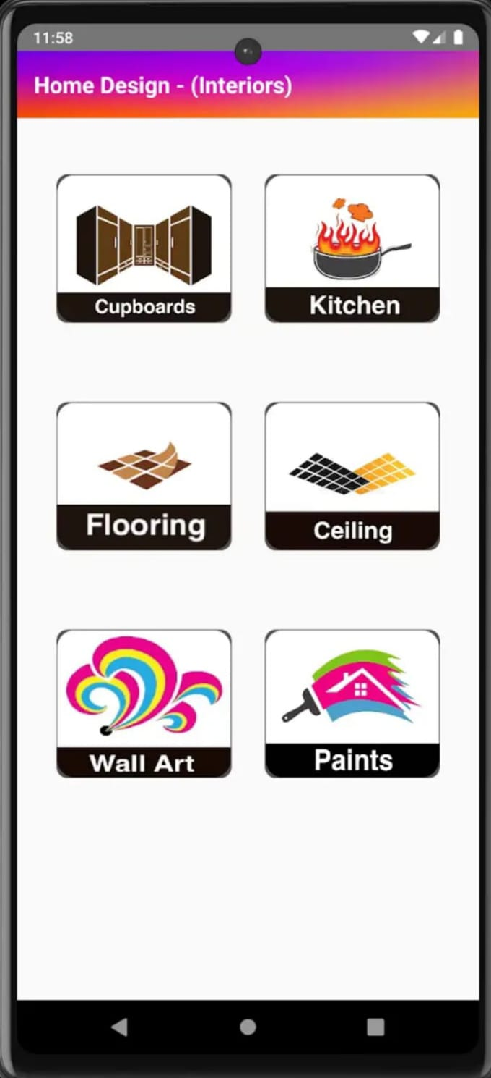
An Android Based Application For Revolutionizing Home Design
BATCH- IT-1
K.V. Hemanth -207Z1A1225
Sheldon Shaji -207Z1A1241
V.Nikil -207Z1A1248

Slide 2

ABSTRACT
The "Home Design App" is an innovative mobile application designed to assist renters, and interior/exterior design in transforming their living spaces.
Not only transforming but also assists you to build the whole structure from the scratch (i.e., core structure).
This app leverages cutting-edge technologies to provide personalized design suggestions, advice, and inspiration for both interior and exterior spaces.
Finally, this app offers a holistic approach to design, transforming the way people approach and execute their design.

Slide 3
REQUIRMENTS
1. SOFTWARE REQUIREMENTS:
• Language : Java
• Tool : Android Studio
• Operating System: Windows 10
2. HARDWARE REQUIREMENTS:
• RAM : 8GB
• Hard Disk: 50GB
• Processor: Dual Core

Slide 4
EXISTING SYSTEM
In the existing system ,we need take the appointment from the architect for the house plans.
And also, for Home Design is a complex and multifaceted process that involves several key stakeholders.
Project management and communication between all parties involved are crucial for a successful build.
Materials are sourced from suppliers, and the construction site is managed to ensure safety and quality.

Slide 5
DISADVANTAGES
Finding the resources may be difficult.
Time consuming.

Slide 6
PROPOSED SYSTEM
The application provides all the Exterior designs and the Interior design and also as per the customer requirement.
In the interior designs it will provide the resources like wall arts, ceiling , Flooring, Paintings, Kitchen, Cupboards.
In the Exterior designs it will provides the house layouts of the 150 acres, 200 acres, 250 acres of the land.
Every layout and design also will be changed or depended on the customer basis.

Slide 7
ADVANTAGES
Resources will be available.
It consumes less time.
Easy to understand the application.

Slide 8
CONCLUSION
It serves as a one-stop solution for anyone looking to enhance the aesthetics and functionality of their homes.
The app boasts an extensive catalog of interior and exterior design elements, including furniture, lighting, paint colors, landscaping options, and more.
Users can explore various products and styles to find the perfect fit for their space, for the creation of functional and aesthetically pleasing living spaces.
It will finally provide all the requirements of the customer perspective for the home designs and development.

Slide 9
THANK YOU

